Slide 1
EEE & CS
Specialist Team - Team 24

Slide 2
Outline:
Introduction: What we needed to create
The requirements of the systems
Design of Systems
Testing the systems
Calibration

Slide 3
Introduction:
The Goal was to create bioreactor control systems to ensure the consistency of production:
Bioreactor:
- A vessel which supports a biologically active environment
- Used to grow yeast cells
Needed to maintain stable:
Temperature
pH
Stirring

Slide 4
Requirements
Subsystem Requirements:
Stirring (500 - 1500 ±20 RPM)
Heating (25-35°C to within ±0.5°C)
Ph (sensing range 3 - 7, optimum 5)
UI and Integration (Suitable for user)
Data logging, monitoring and set point adjustment

Slide 5
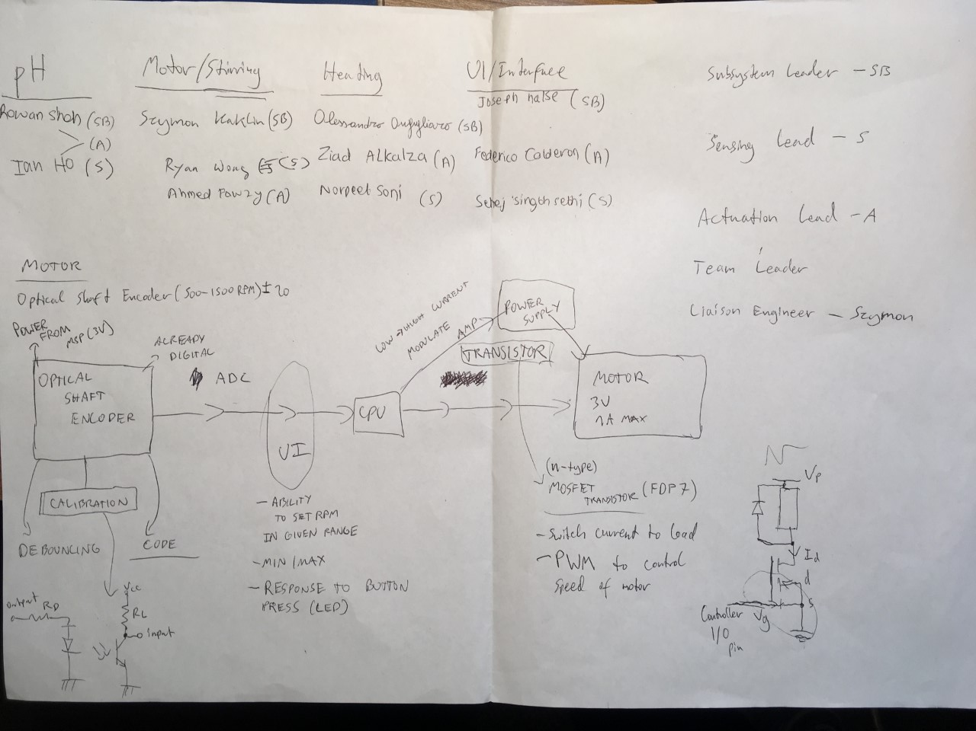
Designing the systems
Assignment of Roles
Block diagrams for each separate subsystem

Slide 6
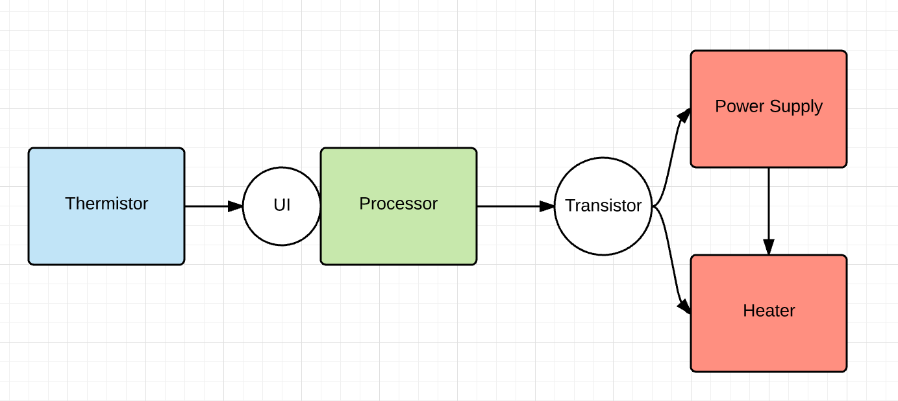
Heating Block Diagram

Slide 7
Heating Circuit
Sensor
Thermistor and resistor in series to create a voltage divider
6V supply from battery
Actuator
Transistor to control the flow of current to the heater.
Signal from microprocessor closes/opens gate of transistor to turn the heater on/off.
12V supply from battery so resistor is used in series, means actual supply to heater is 10V

Slide 8
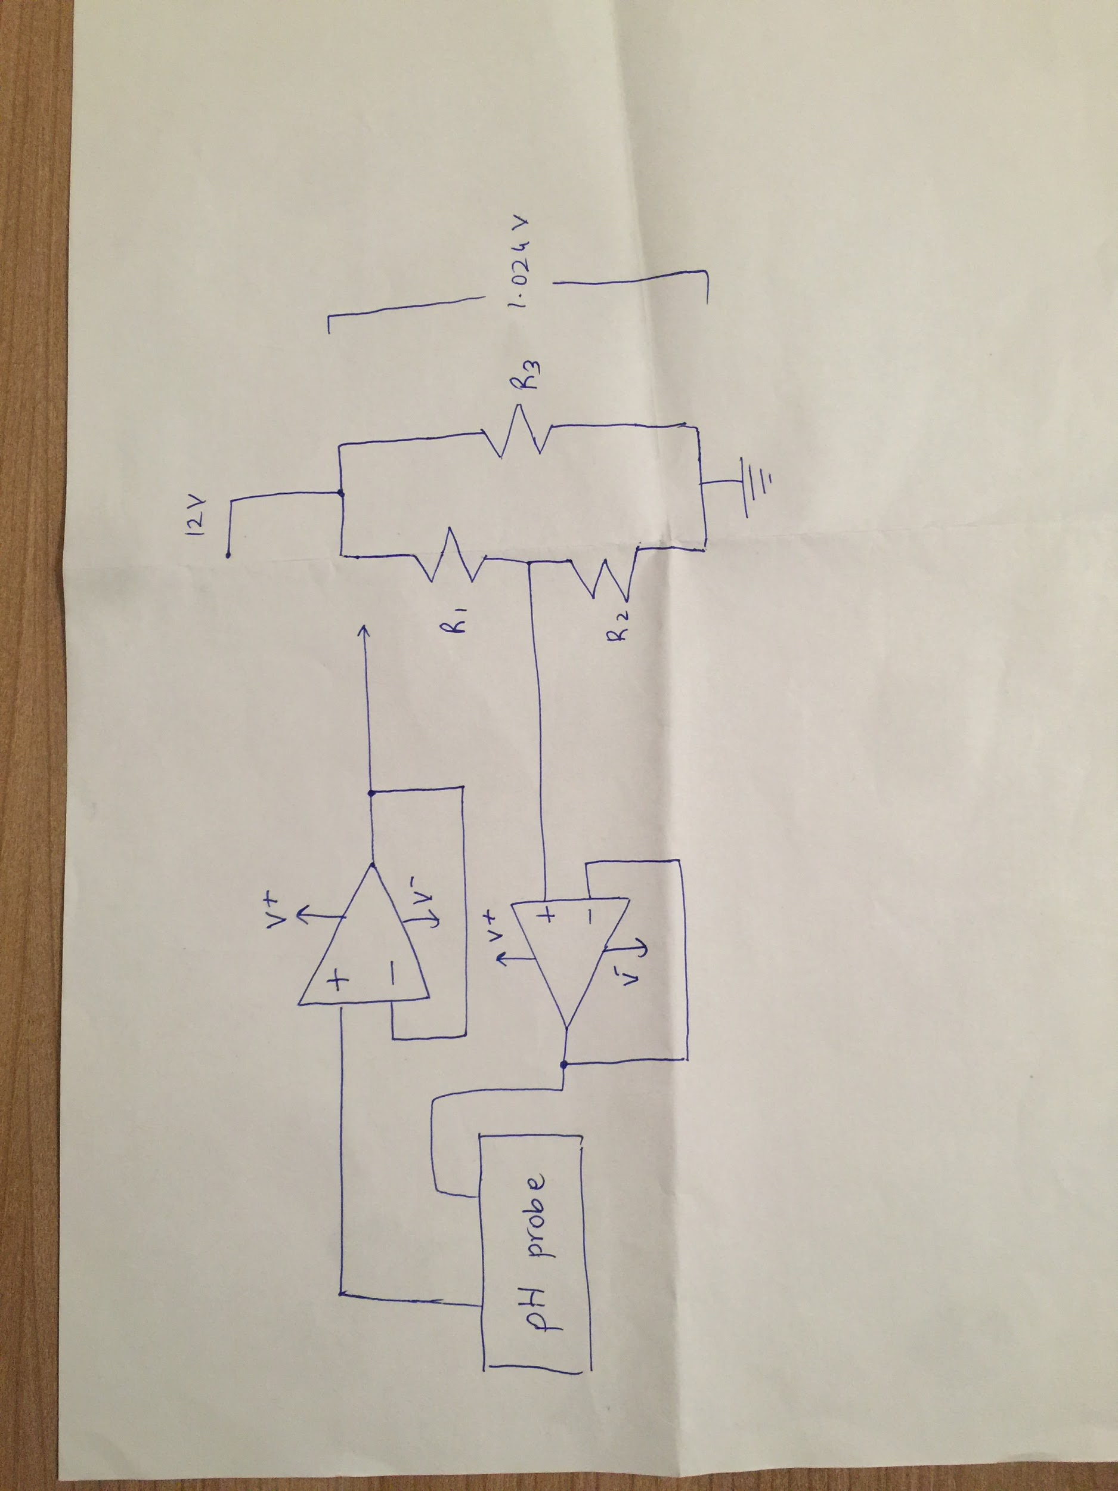
pH Block Diagram

Slide 9
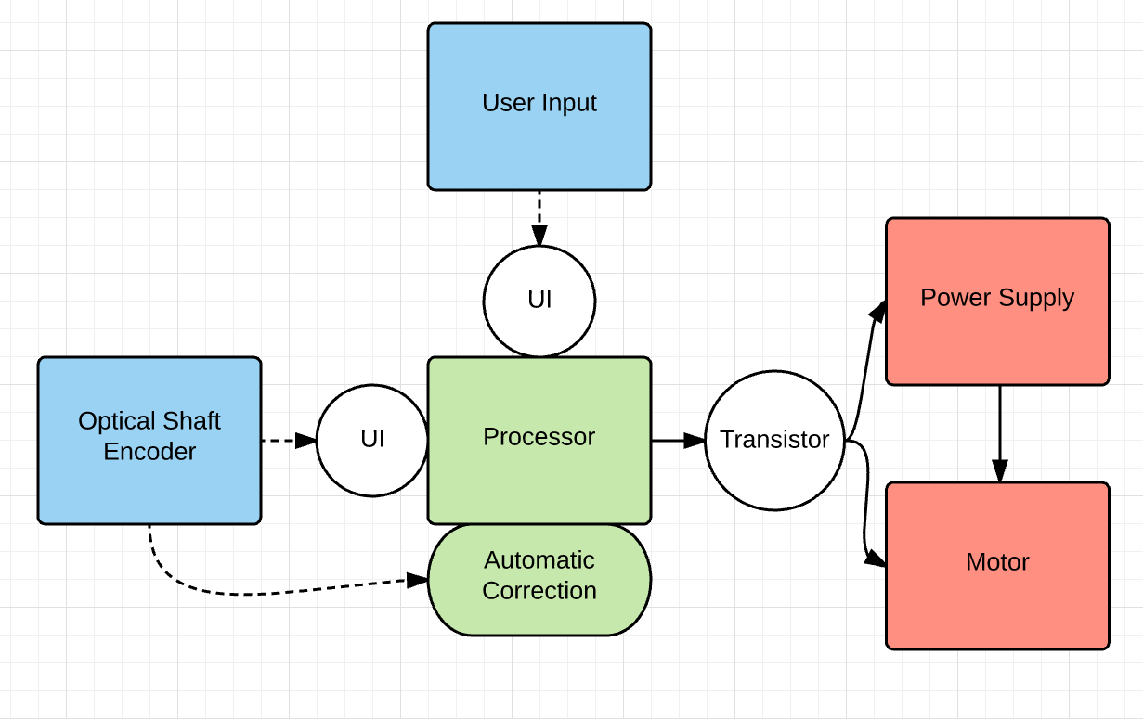
Stirring Block Diagram
Elements:
3V DC Motor (max current 1A)
Photo - Interrupter
Battery

Slide 10
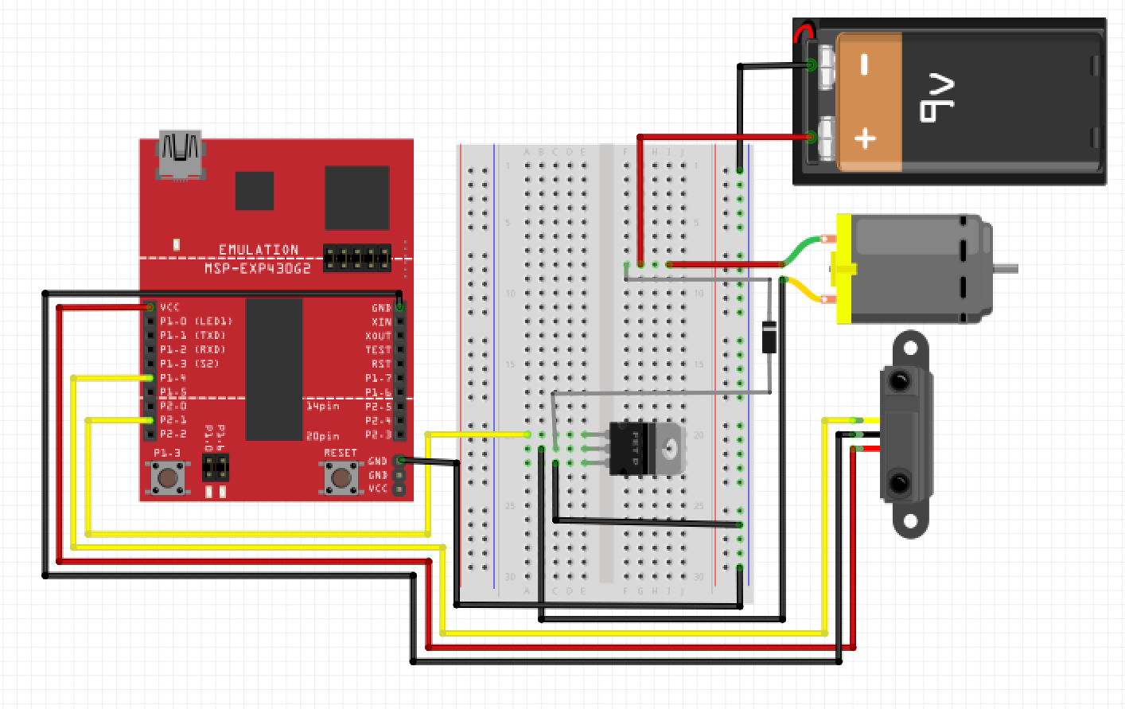

Slide 11
System Testing

Slide 12
Stirring Testing
While testing the stirring:
The program causes the motor to begin at 0 RPM, and speeds up to the required speed
Changed the program to increase in faster increments by changing refresh rate
High RPM causes the water to splash
Set an if condition that turns motor off as safety measure
For RPM to begin measuring, the photo - interrupter must complete two full cycles, as such, autocorrection begins a bit late

Slide 13
Heating testing
We put a thermometer in water and compared the values to the ones on the computer, and checked the system behaviour over time.
When the heater is turned off, it keeps heating the water for a little longer, which increases the temperature by about 1-2°C.
Making it less accurate, since we want the temperature to be of a specific value when it's not.
Turned heater off 1°C below the required temperature, so that when it continues to heat up it doesn't go beyond the set value.

Slide 14
voltage (mV) | pH at 25°C | ph at 35°C
-600 | 13.88015786 | 13.65308994
-500 | 12.16011839 | 11.98981746
-400 | 10.44007893 | 10.32654497
-300 | 8.720039464 | 8.663272485
-200 | 7.478472464 | 7.346789341
-100 | 7.134788246 | 7.045567789
0 | 7 | 7
100 | 6.448675383 | 6.886543358
200 | 4.986437943 | 6.019903671
300 | 2.444685933 | 3.478151661
400 | 0 | 1.033465728
500 | 0 | 0
pH system testing

Slide 15
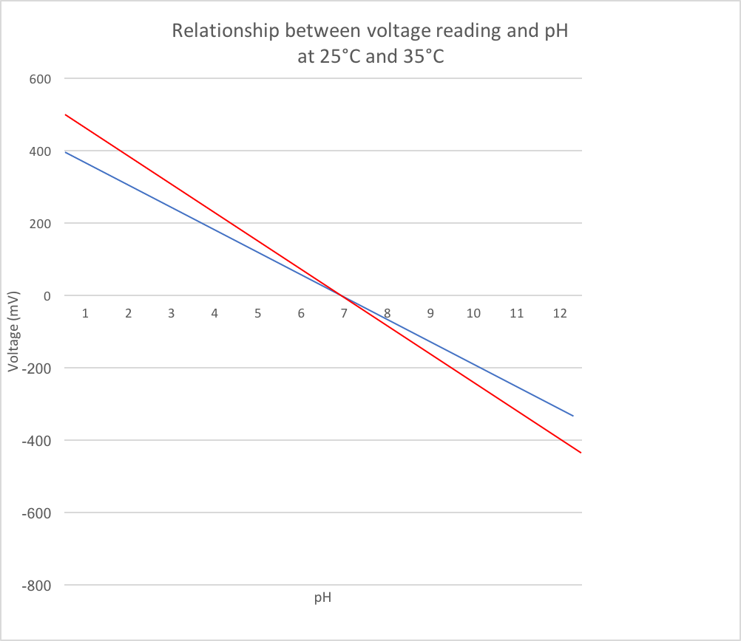
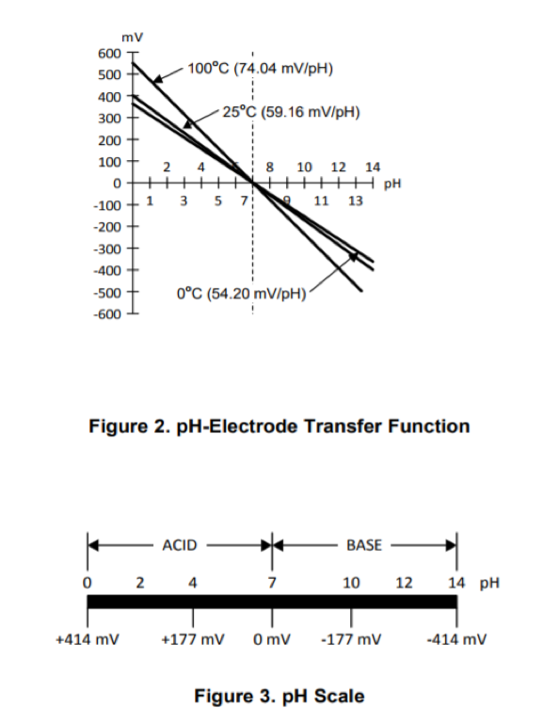
35 degrees
25 degrees

Slide 16
Calibration

Slide 17
Why do we calibrate?
Values regarding the temperature is in voltage, which can be different from circuit to circuit.
That means we need a way to convert the values to degrees.
Makes it clear for users.
Easily used in the processing of data (eg.creating graphs).

Slide 18
Heating Calibration
For calibration we measured the temperature of water using a thermometer and recorded the equivalent voltage (20 data points were sufficient). We repeated this process for different temperatures to get a more accurate result.
Then we used the sets of temperatures with its corresponding voltages to plot a graph and created a relationship between them, which can be used to convert voltages to temperature.

Slide 19
Stirring Calibration
Test value were used to fit the stirring mechanism to the appropriate specifications.
Since RPM had to be in range of 500 - 1500, once we found a maximum comfortably above, we stopped.
Max value: ≈ 3700 RPM (limited by code)
Then, 8 - bit output to transistor was mapped linearly to this (0 - 128)
Assuming that output RPM is directly proportional to PWM value
Proved problematic, as a small change in output corresponded to large change in RPM

Slide 20
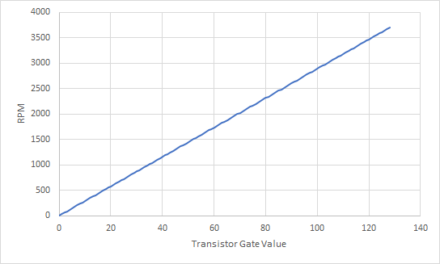
Stirring Calibration
Maximum RPM at 3V (transistor max set to 128)
3700 RPM
Assuming RPM is directly proportional to transistor gate value

Slide 21
pH Calibration
For calibration we measured the pH for previously known liquids, such as water and vinegar to check whether the circuit and code were accurate.
We then recorded the equivalent voltage for different pH values (10 data points were sufficient).
We repeated this process for different to get a more accurate result.
Then we used the sets of pH with its corresponding voltages to plot a graph and create a formula which can be used to understand the trend.

Slide 22



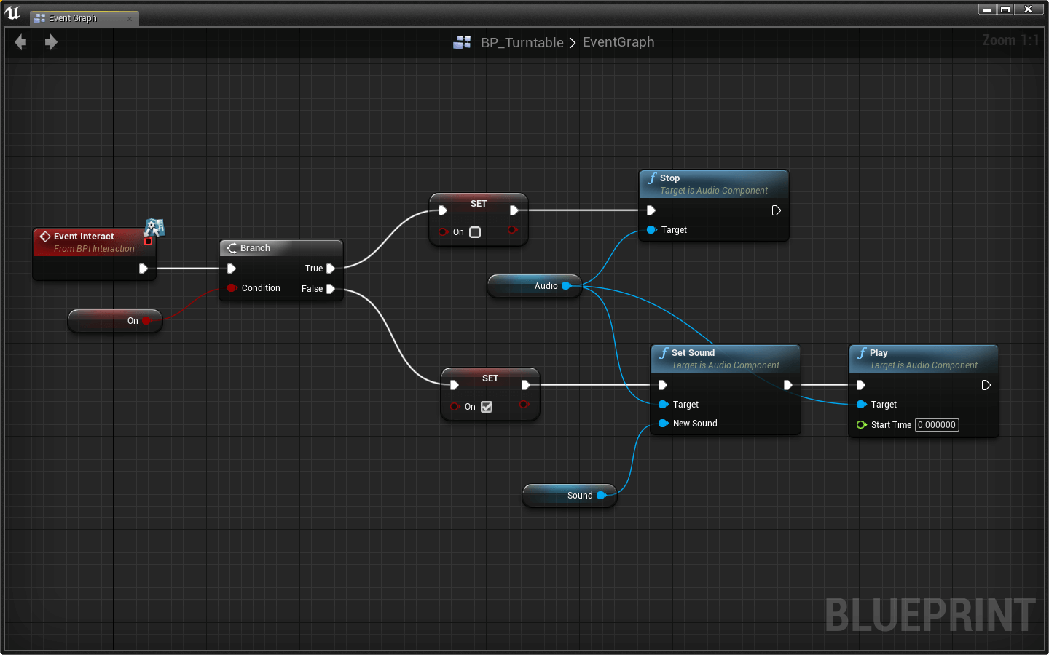

User-Interface
Blueprint Visual Scripting

Slide 23
User-Interface

Slide 24




User-Interface
Combine easily
No code lines
Easy to understand

Slide 25
Conclusion:
We met the most of the required specifications of the bioreactor
Stirring had trouble staying within ± 20, in actuality was close to ± 40
Heating (heating did not stop at the correct point )
pH ( offset not done properly)
UI (full implementation of systems was problematic) - Processing -> Unreal

Slide 26
Pictures references:
https://www.unrealengine.com/download
https://processing.org/download/
http://cliparting.com/free-thumbs-up-clipart-9655/
https://layoutvr.github.io/learn/core_2.html
http://www.clker.com/clipart-28689.html
http://www.bbc.co.uk/news/technology-39114101
https://www.google.co.uk/url?sa=i&rct=j&q=&esrc=s&source=images&cd=&ved=0ahUKEwjUk4Pl34fYAhXP66QKHT4YDvIQjxwIAw&url=http%3A%2F%2Fhuntingtonoutdoor.com%2F2016%2F09%2F16%2Fwill-design-look-like-billboard%2F&psig=AOvVaw0l12y1MzQFoXgeHRI8Ckhy&ust=1513280605406756
https://32414320wji53mwwch1u68ce-wpengine.netdna-ssl.com/wp-content/uploads/2013/04/python-logo-236x300.png
https://github.com/isocpp/logos

